Slide 1
UMD DATA605 - Big Data Systems MapReduce Framework Fundamentals and Algorithms
GP Saggese
gsaggese@umd.edu
with thanks to Alan Sussman, Amol Deshpande, and authors of www.mmds.org

Slide 2
Sources:
Silbershatz: Chap 10

Slide 3
Big Data: Sources and Applications
Growth of World Wide Web in 1990s and 2000s resulted in storing and querying data much larger than enterprise data, e.g.,
Web server logs
Web links
Social media
Data from mobile phone apps
Transaction data
Data from sensors (Internet of Things)
Metadata from communication data
Extremely valuable data to target advertisements and for marketing
Big Data is characterized by:
Volume:
Amount of data to store and process is much larger than traditional DBs
Too big even for parallel DB systems with 10-100 machines
Velocity
Ingest and store data at very high rate (due to rate of arrival of data)
Data might need to be processed in real-time (e.g., streaming systems)
Variety
Not all data is relational (e.g., semi-structured, textual, graph data)
Data is processed by systems with 10,000-100,000 machines

Slide 4
Big Data: Sources and Applications
Web server logs
Record user interactions with web servers
Billions of users click on thousands links per day -> TB of data per day
Web logs contain important information to
Decide what information (e.g., posts, news) to present to users to keep them engaged
E.g., what user has viewed, what other similar users has viewed
Decide what advertisements to show to which users to maximize benefit to the advertiser
Websites are paid for click-through or conversion
Understand visit patterns of different website to make it easy for users to find information
Determine user preferences and trends to inform business decisions
Click-through and conversion
Click-through = a user clicks on an advertisement to get more information
It is a measure of success in getting user attention
Conversion = when a user actually purchases the advertised product or service

Slide 5
Big Data Storage Systems
Distributed file systems
E.g., store large files like log files
Sharding across multiple DBs
= partitioning records across multiple systems
Key-value stores
Data stored and retrieved based on a key
Limitations on semantics, querying (with respect to relational DBs)
E.g., NoSQL
Parallel and distributed DBs
Traditional relational DB interface
Store data across multiple machines
Perform queries across multiple machines

Slide 6
1) Distributed File Systems
Allow files to be stored across a number of machines, giving a single file-system view to clients
E.g., Google File System (GFS)
E.g., Hadoop File System (HDFS) based on GFS architecture
Files are broken into multiple blocks and partitioned across multiple machines (typically with some replication across machines)

Slide 7
2) Sharding across multiple DBs
Process of partitioning records across multiple DBs or machines
E.g., to scale beyond a centralized DB to handle more users or storage / processing speed
Shard keys (aka partitioning keys / attributes) are one or more attributes to partition the data
Range partition
Hash partition
Replication is often needed to deal with failures
Ensuring consistency is challenging

Slide 8
3) Key-value store
Records are stored, updated, and retrieved based on a key, with some limited query facilities
NoSQL systems
Key-value store do not support:
Declarative querying
Transactions
Retrieval based on non-key attributes
These features are sacrificed to achieve scalability on large clusters
Problems solved by key-value storage
Many applications (e.g., web) store a very large number (billions or more) small records (few KBs to few MBs)
File systems are not designed to store such a large number of files
Relational DBs are not good at supporting constraints (e.g., foreign key) and transactions on multiple machines
Key-value stores can:
Partition data across multiple machines easily
Support replication and consistency
Balance workload and add more machines

Slide 9
Parallel key-value stores
Parallel key-value stores
Bigtable (Google)
Apache HBase
Dynamo (Amazon)
Cassandra (Facebook)
MongoDB
Azure cloud storage (Microsoft)
Document stores
Allow storing data with certain format and execute simple queries
E.g., MongoDB accepts values in JSON format
Conceptually the operations are:
`put(key, value)` to store
`get(key)` to retrieve data
MongoDB cluster
Scale out on large data sizes and query / update loads with multiple machines
Partitioning is done based on the value of a specified attribute (partitioning attribute)
Bigtable
Data values can have multiple attributes (not predetermined and changing across records) JSON can be mapped to Bigtable data model
HBase is the open-source version
In-memory caching systems
Store some relations or parts of some relations in in-memory cache
Replicated or partitioned across multiple machines
E.g., memcached or Redis

Slide 10
4) Parallel / distributed DBs
DBs that storing and processing data running on multiple machines (aka "cluster")
From a programmer viewpoint, a parallel DB can be used just as a DB running on a single machine
Can run on 10s-100s of machines
Data is replicated for performance and reliability
Since failures are infrequent with 100s of machines, a query can be just restarted using a different machine
Adding ability to run a query incrementally requires a lot of complexity
This is a limit to the scalability

Slide 11
MapReduce
Challenges
How to distribute computation?
How can we make it easy to write distributed programs?
Distributed / parallel programming is hard
How to store data?
How to survive failures?
One server may stay up 3 years (1,000 days)
If you have 1,000 servers, expect to lose 1/day
E.g., ~1M machines (Google in 2011) 1,000 machines fail every day!
MapReduce addresses this problem for certain kinds of computations
Started as Google’s computational / data manipulation model
An elegant way to work with big data

Slide 12
MapReduce: Google Example
20+ billion web pages for a total ~5m TBs
~1m hard drives to store the web
1 computer reads 300 MB/sec from disk
5e6 * 1024 * 1024 * 8 / 300 / 3600 / 24 / 365
= 4433 years to read the web
Takes even more to do something useful with the data!
Today, a standard architecture for such problems has emerged:
Cluster of commodity Linux nodes
Commodity network (typically Ethernet) to connect them

Slide 13
Cluster Architecture
2-10 Gbps backbone between racks
1 Gbps between
any pair of nodes
in a rack
Switch
Switch
Switch
CPU
CPU
CPU
CPU
Mem
…
Mem
Mem
…
Mem
Disk
Disk
Disk
Disk
Each rack contains 16-64 nodes
In 2011 it was guesstimated that Google had 1M machines, http://bit.ly/Shh0RO

Slide 14
Idea and Solution
Issue: Copying data over a network takes time
Idea:
Bring computation close to the data
Store files multiple times for reliability
MapReduce addresses these problems
Storage Infrastructure – File system
Google: GFS
Hadoop: HDFS
Programming model
Map-Reduce

Slide 15
Storage Infrastructure
Problem:
If nodes fail, how to store data persistently?
Typical usage pattern
Huge files (100s of GB to TB)
Data is rarely updated in place
Reads and appends are common
Solution: Distributed File System
Allow files to be stored across a number of machines
Give a single file-system view to clients
Files are broken into multiple blocks and partitioned across multiple machines
Typically with replication across machines

Slide 16
Distributed File System
Reliable distributed file system
Data kept in “chunks” spread across machines
Each chunk replicated on different machines
Seamless recovery from disk or machine failure
C₀
C₁
D₀
C₁
C₂
C₅
C₀
C₅
D₀
D₁
…
D₀
C₅
C₂
C₅
C₃
C₂
Chunk server 1
Chunk server 2
Chunk server 3
Chunk server N
Bring computation directly to the data!
Chunk servers also serve as compute servers
Notes:
‹#›

Slide 17
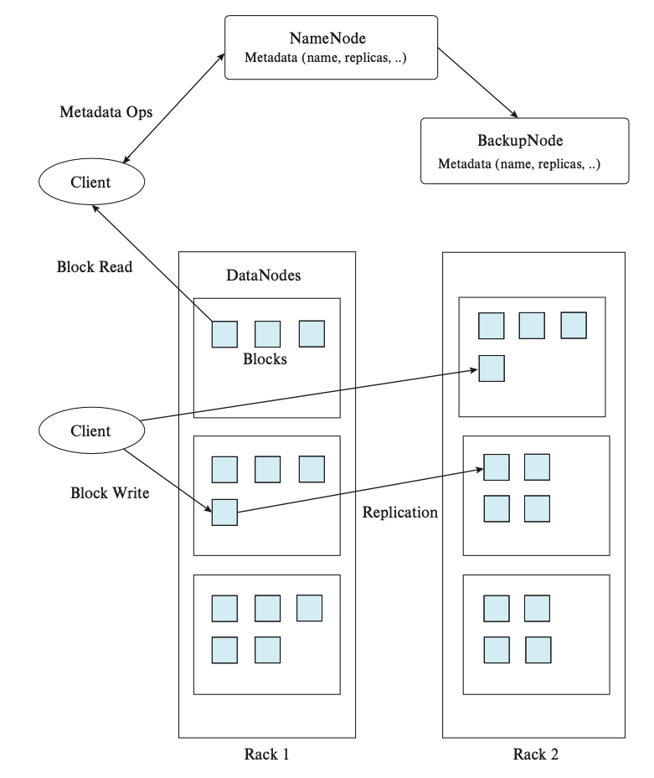
Hadoop Distributed File System
DataNodes
Store data blocks
File is split into contiguous blocks
Typically each block is 16-64MB
Each chunk is replicated (usually 2x or 3x)
Try to keep replicas in different racks
NameNode
Store file / dir hierarchy
Store metadata about where files are stored
Library for file access
Read:
Talk to NameNode to find NameNode and pointer to block
Connect directly to NameNode to access data
Write:
NameNode creates blocks
Assign blocks to several DataNodes
Client sends data to assigned DataNodes
DataNodes store data
Client
API (e.g,. Python, Java) to library
Mount HDFS on local filesystem

Slide 18
Programming Model: MapReduce
Hello-world of MapReduce
Word Count
We have a huge text document
Count the number of times each distinct word appears in the file
Sample application:
Analyze web server logs to find popular URLs

Slide 19
MapReduce: Overview
Inspired by functional programming (e.g., Lisp)
Common pattern of parallel programming
The same function `map()` is applied to each of a large number of records
A form of aggregation `reduce()` is applied to the result of `map()`
Example: sum the length of all the strings in a document
Map(function, set of values)
Apply function to each value in the set (map length (() (a) (a b) (a b c))) ⇒ (0 1 2 3)
Reduce(function, set of values)
Combine all the values using a binary function (e.g.,+) (reduce add (1 2 3 4 5)) ⇒ 15

Slide 20
MapReduce: Overview
Read input
Sequentially or in parallel
Map
Extract / compute something from inputs
Group by key
Sort and shuffle
Reduce
Aggregate, summarize, filter, or transform
Write the result
Structure of computation stays the same
Map and Reduce change to fit the problem

Slide 21
MapReduce: Word Count
The Problem:
Count occurrences of words in a document:
> more doc.txt
The crew of the space shuttle Endeavor recently returned to Earth as ambassadors, harbingers of a new era of space exploration...
> words(doc.txt) | sort | uniq -c
words() takes a file and outputs the words, one per line
This pipeline captures the essence of MapReduce
It is naturally parallelizable

Slide 22
MapReduce: Word Count
Read input
Map:
Invoked on each input record
Emit 0 or more output data items
Group by key:
Gather all outputs from Map()
Reduce:
Combine the list of outputs with same keys
map(key, value):
# key: document name
# value: document text
for each word w in value:
emit(w, 1)
reduce(key, values):
# key: a word
# value: an iterator over counts
result = 0
for each count v in values:
result += v
emit(key, result)
“One a penny, two a penny, hot cross buns.”
Output of Map
(“one”, 1), (“a”, 1), (“penny”, 1),(“two”, 1), (“a”, 1), (“penny”, 1), (“hot”, 1), (“cross”, 1), (“buns”, 1)
Output of GroupBy
(“a”, [1,1]), (“buns”, [1]) (“cross”, [1]), (“hot”, [1]), (“one”, [1]), (“penny”, [1,1]), (“two”, [1])
Output of Reduce
(“one”, 1), (“a”, 2), (“penny”, 2), (“two”, 1), (“hot”, 1), (“cross”, 1), (“buns”, 1)

Slide 23
MapReduce: Word Count
Provided by the programmer
Provided by the programmer
Map:
Read input Produce a set of key-value pairs
Group by key:
Collect all pairs with same key
Reduce:
Collect all values belonging to the key and output
The crew of the space shuttle Endeavor recently returned to Earth as ambassadors, harbingers of a new era of space exploration. Scientists at NASA are saying that the recent assembly of the Dextre bot is the first step in a long-term space-based man/mache partnership. '"The work we're doing now -- the robotics we're doing -- is what we're going to need ……………………..
(The, 1)
(crew, 1)
(of, 1)
(the, 1)
(space, 1)
(shuttle, 1)
(Endeavor, 1)
(recently, 1)
….
(crew, 1)
(crew, 1)
(space, 1)
(the, 1)
(the, 1)
(the, 1)
(shuttle, 1)
(recently, 1)
…
(crew, 2)
(space, 1)
(the, 3)
(shuttle, 1)
(recently, 1)
…
Only sequential reads
Big document
(key, value)
(key, value)
(key, value)

Slide 24
MapReduce: Map Step
Input
key-value pairs
Intermediate
key-value pairs
k
v
map(key, value):
# key: document name
# value: document text
for each word w in value:
emit(w, 1)
map
k
v
k
v
map
k
v
k
v
…
…
k
v
k
v

Slide 25
MapReduce: Reduce Step
reduce(key, values):
# key: a word
# value: an iterator over counts
result = 0
for each count v in values:
result += v
emit(key, result)
Output
key-value pairs
Intermediate
key-value pairs
Key-value groups
reduce
k
v
k
v
v
v
k
v
Group
by key
reduce
k
v
k
v
v
k
v
k
v
…
…
…
k
v
k
v
k
v

Slide 26
MapReduce: Details
Input: read a set of key-value pairs List[Tuple[k, v]]
Programmer specifies two methods map and reduce
Map(Tuple[k, v]) → List[Tuple[k, v]]
Take a key-value pair and outputs a set of key-value pairs
E.g., key is a file (or a row), value is the number of occurrences
E.g., “One a penny” -> (“One”, 1), (“a”, 1), (“penny”, 1)
There is one Map call for every (k,v) pair
Group By → List[Tuple[k, List[v]]]
Group and optionally sorts all records with the reduce key
Reduce(List[Tuple[k, List[v]])) → Tuple[k, v]
All values v’ with same key k’ are reduced together and processed in v’ order
There is one Reduce call per unique key k’
Output: write key-value pairs List[Tuple[k, v]]

Slide 27
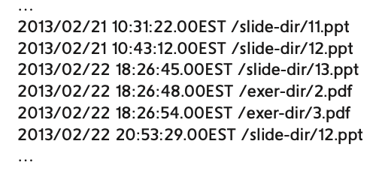
MapReduce: Log Processing
Log file recording access to a website
Format: Date, hour, filename
Goal: Find how many times each files is accessed during Feb 2013
Input:
Read the file and split in lines
Map:
parse each line in the 3 fields
if the date is in the required interval emit(dir_name, 1)
E.g., [(`/slide-dir/11.ppt`, 1), ...]
GroupBy:
The reduce key is the filename
Accumulate all the (key, value) with the same filename
E.g., [(`/slide_dir/11.ppt`, 1), ..., (`/slide-dir/12.ppt`, [1, 1]), ...]
Reduce:
Add the values for each list of (key, value) since they have the same filename
Output the number of access to each file
Output:
Write results on disk

Slide 28
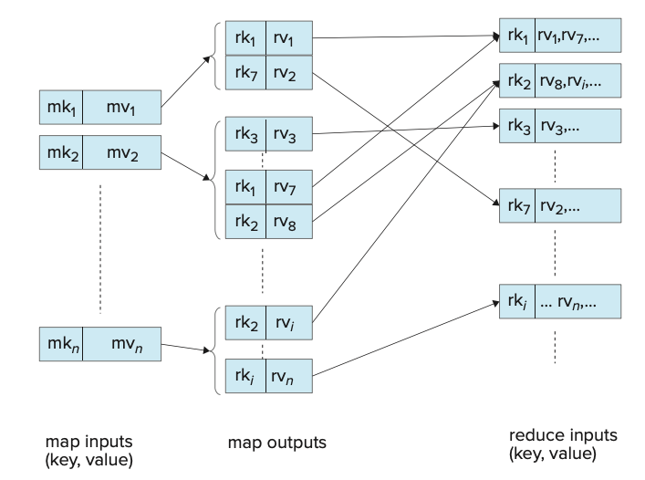
MapReduce: Serial Data Flow
Map
mk_i are map keys
mv_i are map input values
GroupBy
Reduce
rk_i are reduce keys
rv_i reduce input values
Reduce outputs are not shown

Slide 29
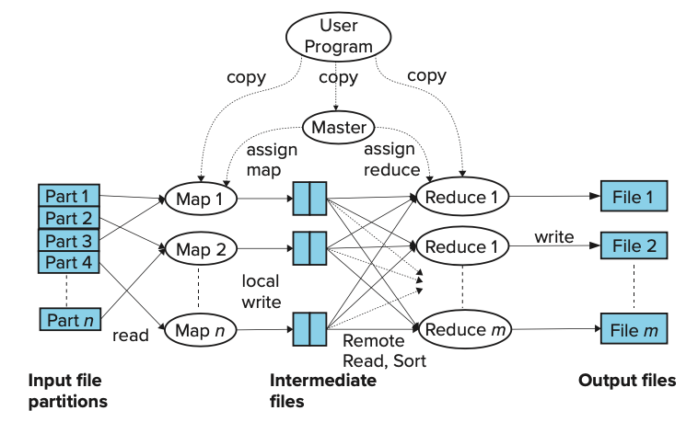
MapReduce: Parallel Data Flow
So far focus on MapReduce functionality
MapReduce enables parallel processing
User program specifies map and reduce code
Input data is partitioned across multiple machines (HDFS)
Master node sends copies of the code to all computing nodes
Map
Functions executed in parallel on multiple machines
Each work on some part of the data
Output data from Map is saved on disk
GroupBy / Sort
Output data from Map is sorted and partitioned based on reduce key
Different files are created for each Reduce task
Reduce
Functions executed in parallel on multiple machines
Each work on some part of the data
Output data from Reduce is saved on disk

Slide 30
MapReduce: Environment
Hadoop is an open-source implementation of MapReduce
Hadoop run-time takes care of:
Partitioning the input data (HDFS)
Input adapters
E.g., HBase, MongoDB, Cassandra, Amazon Dynamo
Scheduling the program’s execution across a set of machines
Performing the group by key step
Handling machine failures
Managing required inter-machine communication
Output adapters
E.g., Avro, ORC, Parquet
Schedule multiple MapReduce jobs

Slide 31
Data Flow
Input and final output are stored in a distributed file system (FS):
Scheduler tries to schedule map tasks “close” to physical storage location of input data
Intermediate results are stored on local FS of Map and Reduce workers
Output is often input to another MapReduce task

Slide 32
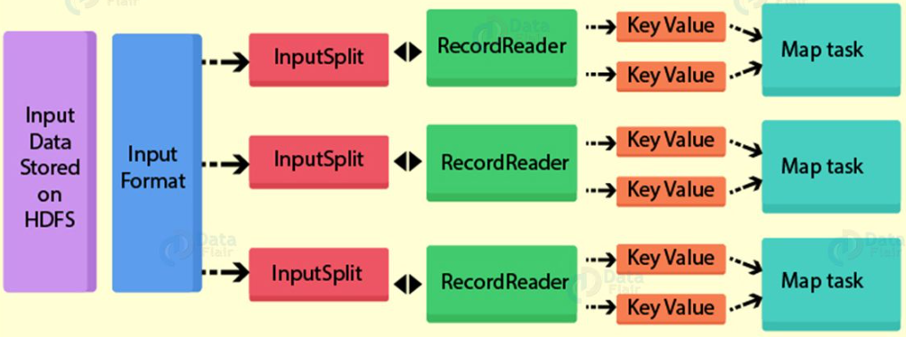
Input Files
Input files are where the data for a MapReduce task is initially stored
The input files typically reside in a distributed file system (e.g., HDFS)
The format of input files is arbitrary
Line-based log files
Binary files
Multi-line input records
Or something else entirely
E.g., an SQL database

Slide 33
InputFormat
How the input files are split up and read is defined by the InputFormat
InputFormat is a class that does the following:
Select the files that should be used for input
Defines the InputSplits that break a file
Provides a factory for RecordReaders objects that read the file
InputFormat | Description | Key | Value
TextInputFormat | Default format; reads lines of text files | The byte offset of the line | The line contents
KeyValueInputFormat | Parses lines into (K, V) pairs | Everything up to the first tab character | The remainder of the line
SequenceFileInputFormat | A Hadoop-specific high-performance binary format | user-defined | user-defined

Slide 34
Input Splits
InputSplit: describe a unit of work that comprises a single map task in a MapReduce program
By default, the InputFormat breaks a file up into 64MB splits
By dividing the file into splits, we allow several map tasks to operate on a single file in parallel
Each map task corresponds to a single input split

Slide 35
RecordReader
The input split defines a slice of work but does not describe how to access it
The RecordReader class actually loads data from its source and converts it into (K, V) pairs suitable for reading by Mappers
The RecordReader is invoked repeatedly on the input until the entire split is consumed
Each invocation of the RecordReader lead to another call of the map function defined by the programmer

Slide 36
OutputFormat
The OutputFormat class defines the way (K,V) pairs produced by Reducers are written to output files
The instances of OutputFormat provided by Hadoop write to files on the local disk or in HDFS
Several OutputFormats are provided by Hadoop:
Files loaded from local HDFS store
InputFormat
file
Split
Split
Split
file
RR
RR
RR
OutputFormat | Description
TextOutputFormat | Default; writes lines in "key \t value" format
SequenceFileOutputFormat | Writes binary files suitable for reading into subsequent MapReduce jobs
NullOutputFormat | Generates no output files
Map
Map
Map
OutputFormat | Description
TextOutputFormat | Default; writes lines in "key \t value" format
SequenceFileOutputFormat | Writes binary files suitable for reading into subsequent MapReduce jobs
NullOutputFormat | Generates no output files
OutputFormat | Description
TextOutputFormat | Default; writes lines in "key \t value" format
SequenceFileOutputFormat | Writes binary files suitable for reading into subsequent MapReduce jobs
NullOutputFormat | Generates no output files
OutputFormat | Description
TextOutputFormat | Default; writes lines in "key \t value" format
SequenceFileOutputFormat | Writes binary files suitable for reading into subsequent MapReduce jobs
NullOutputFormat | Generates no output files
Partitioner
Sort
Reduce
OutputFormat

Slide 37
Coordination: Master
Master node takes care of coordination:
Task status: (idle, in-progress, completed)
Idle tasks get scheduled as workers become available
When a Map task completes, it sends the master the location and sizes of its R intermediate files, one for each Reducer
Master pushes this info to Reducers
Master pings workers periodically to detect failures

Slide 38
Dealing with Failures
Map worker failure
Map tasks completed or in-progress at worker are reset to idle
Reduce workers are notified when task is rescheduled on another worker
Reduce worker failure
Only in-progress tasks are reset to idle
Reduce task is restarted
Master failure
MapReduce task is aborted and client is notified

Slide 39
How many Map and Reduce jobs?
M map tasks, R reduce tasks
Rule of a thumb:
Make M much larger than the number of nodes in the cluster
Pros
Improve dynamic load balancing
Speed up recovery from worker failures
Cons
More communication between Master and Nodes
Smaller files
Usually R is smaller than M
Output is spread across fewer files

Slide 40
Refinements: Backup Tasks
Problem
Slow workers significantly lengthen the job completion time
Slow workers due to:
Older processor
Not enough RAM
Other jobs on the machine
Bad disks
OS thrashing / virtual memory hell
Solution
Near end of Map / Reduce phase, spawn backup copies of tasks
Whichever one finishes first “wins”
Effect
Dramatically shortens job completion time

Slide 41
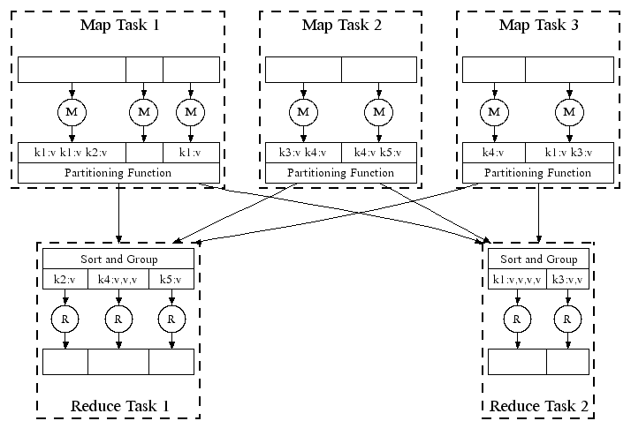
Refinement: Combiners
Problem: often a Map task produce many pairs for the same key k, e.g., (k,v₁), (k,v₂), …
E.g., common words in the word count example
Solution:
Pre-aggregate values in the Mapper
combine(k, list(v₁,v₂))
Combiner is usually same as the reduce function
Works only if Reduce function is commutative and associative
Effect:
Better data locality
Less shuffling and reordering
Less network / disk traffic

Slide 42
Refinement: Partition Function
Want to control how keys get partitioned
Inputs to map tasks are created by contiguous splits of input file
Reduce needs to ensure that records with the same intermediate key end up at the same worker
System uses a default partition function:
hash(key) mod R
Sometimes useful to override the hash function:
E.g., hash(hostname(URL)) mod R ensures URLs from a host end up in the same output file

Slide 43
Problems Suited for Map-Reduce

Slide 44
Applications
Three major classes:
Text tokenization, indexing, and search
Creation of other kinds of data structures (e.g., graphs)
Data mining and machine learning
Link analysis and graph processing

Slide 45
Example: Language Model
Statistical machine translation:
Need to count number of times every 5-word sequence occurs in a large corpus of documents
Very easy with MapReduce:
Map:
Extract (5-word sequence, count) from document
Reduce:
Combine the counts

Slide 46
Cost Measures for Algorithms
In MapReduce we quantify the cost of an algorithm using
Communication cost = total I/O of all processes
Elapsed communication cost = max of I/O along any path
(Elapsed) computation cost analogous, but count only running time of processes
Note that here the big-O notation is not the most useful (adding more machines is always an option)

Slide 47
Example: Cost Measures
For a map-reduce algorithm:
Communication cost = input file size + 2 × (sum of the sizes of all files passed from Map processes to Reduce processes) + the sum of the output sizes of the Reduce processes.
Elapsed communication cost is the sum of the largest input + output for any map process, plus the same for any reduce process

Slide 48
What Cost Measures Mean
Either the I/O (communication) or processing (computation) cost dominates
Ignore one or the other
Total cost tells what you pay in rent from your friendly neighborhood cloud provider
Elapsed cost is wall-clock time using parallelism

Slide 49
Cost of Map-Reduce Join
Total communication cost = O(|R|+|S|+|R ⋈ S|)
Elapsed communication cost = O(s)
We’re going to pick k and the number of Map processes so that the I/O limit s is respected
We put a limit s on the amount of input or output that any one process can have. s could be:
What fits in main memory
What fits on local disk
With proper indexes, computation cost is linear in the input + output size
So computation cost is like comm. cost

Slide 50
MapReduce vs. Databases

Slide 51
History
Abstract ideas have been known before
See MapReduce and Parallel DBMSs by Stonebraker et al.
Can be implemented using user-defined aggregates in PostgreSQL quite easily
Top-down, declarative design
The user specifies what is to be done, not how many machines to use, etc...
The strength comes from simplicity and ease of use
No database system can come close to the performance of MapReduce infrastructure
RDBMSs can’t scale to that degree, are not as fault-tolerant, etc.
This is mainly because of ACID
Databases were designed to support it
Most MapReduce tasks/applications don’t worry about that

Slide 52
History
MapReduce is very good at what it was designed for
But may not be ideal for more complex tasks
E.g., no notion of “Query Optimization” (in particular, operator order optimization)
The sequence of MapReduce tasks makes it procedural within a single machine
Joins are tricky to do
MapReduce assumes a single input
However, much work in recent years on extending the basic functionality

Slide 53
Example: Join By Map-Reduce
Compute the natural join R(A,B) ⋈ S(B,C)
R and S are each stored in files
Tuples are pairs (a,b) or (b,c)
A | B
a₁ | b₁
a₂ | b₁
a₃ | b₂
a₄ | b₃
B | C
b₂ | c₁
b₂ | c₂
b₃ | c₃
A | C
a₃ | c₁
a₃ | c₂
a₄ | c₃
⋈
=
S
R

Slide 54
Map-Reduce Join
Use a hash function h from B-values to 1...k
A Map process turns:
Each input tuple R(a,b) into key-value pair (b,(a,R))
Each input tuple S(b,c) into (b,(c,S))
Map processes send each key-value pair with key b to Reduce process h(b)
Hadoop does this automatically; just tell it what k is.
Each Reduce process matches all the pairs (b,(a,R)) with all (b,(c,S)) and outputs (a,b,c).

Slide 55
Systems on MapReduce
See Hadoop home page for links to more systems and project links
Pig - high-level data-flow language and execution framework for parallel computation
HBase - scalable, distributed database that supports structured data storage for large tables (like Google BigTable)
Cassandra - scalable multi-master database with no single points of failure
Hive - data warehouse infrastructure that provides data summarization and ad hoc querying
ZooKeeper - high-performance coordination service for distributed applications

Slide 56
Pointers and Further Reading

Slide 57
Implementations
Google
Not available outside Google
Hadoop
An open-source implementation in Java
Uses HDFS for stable storage
Download: http://hadoop.apache.org/
Amazon Elastic MapReduce (EMR)
Hadoop MapReduce running on Amazon EC2
Can also run Spark, Hbase, Hive, …

Slide 58
Reading
Jeffrey Dean and Sanjay Ghemawat: MapReduce: Simplified Data Processing on Large Clusters
https://research.google.com/archive/mapreduce-osdi04.pdf
Sanjay Ghemawat, Howard Gobioff, and Shun-Tak Leung: The Google File System
https://research.google.com/archive/gfs-sosp2003.pdf

Slide 59
Resources
Hadoop Wiki
Introduction
https://wiki.apache.org/hadoop
Getting Started
http://wiki.apache.org/hadoop/GettingStartedWithHadoop
Map/Reduce Overview
http://wiki.apache.org/hadoop/HadoopMapReduce
http://wiki.apache.org/hadoop/HadoopMapRedClasses
Eclipse Environment
https://wiki.apache.org/hadoop/EclipsePlugIn
Javadoc
http://hadoop.apache.org/docs/current/api/

